Slide 1
Market Intelligence Report
4/12/2023

Slide 2
TABLE OF CONTENTS
This Week in the News
Electricity & Gas Opportunity Map
Fundamental Market Drivers
NOAA Weather Forecasts
CRUDE Oil – 12 Month Strip
Henry Hub Nat Gas – 12 Month Strip
NYMEX Monthly Settlements
Natural Gas Futures Pricing
Natural Gas Storage Report
NYISO (NY) – 12M Flat Forward Pricing
PJM West Hub – 12M Flat Forward Pricing
PJM NI (Midwest) – 12M Flat Forward Pricing
MASS Hub (MA) – 12M Flat Forward Prices
ERCOT (TX) – 12M Flat Forward Prices
CAISO (CA) – 12M Flat Forward Prices
PJM Capacity Prices
PJM NITS Prices

Slide 3
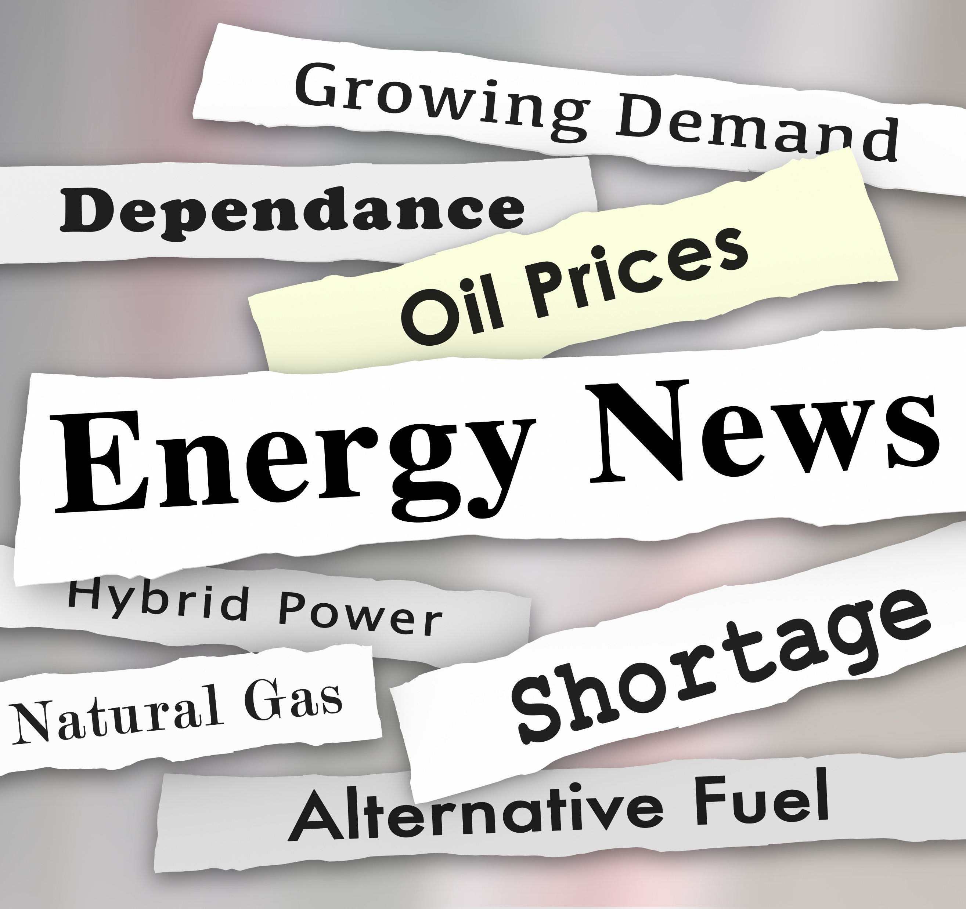
THIS WEEK IN THE NEWS
Inflation Reduction Act Spurs Growth in Renewables, Longer Interconnection Times.
High Natural Gas Inventories Drive Near-Term Prices Lower.
Northeast States Petition for $1.25 Billion in Federal Subsidies for Clean Hydrogen Hub.
Global Coal Consumption Grows Despite Promises to Scale Back.
OPEC+ to Reduce Oil Production by 1.66 Million Barrels/Day in Effort to Boost Prices.
U.S. LNG Exports Continue to Set New Records.
EPA Strengthens Auto Emissions Goals.

Slide 4
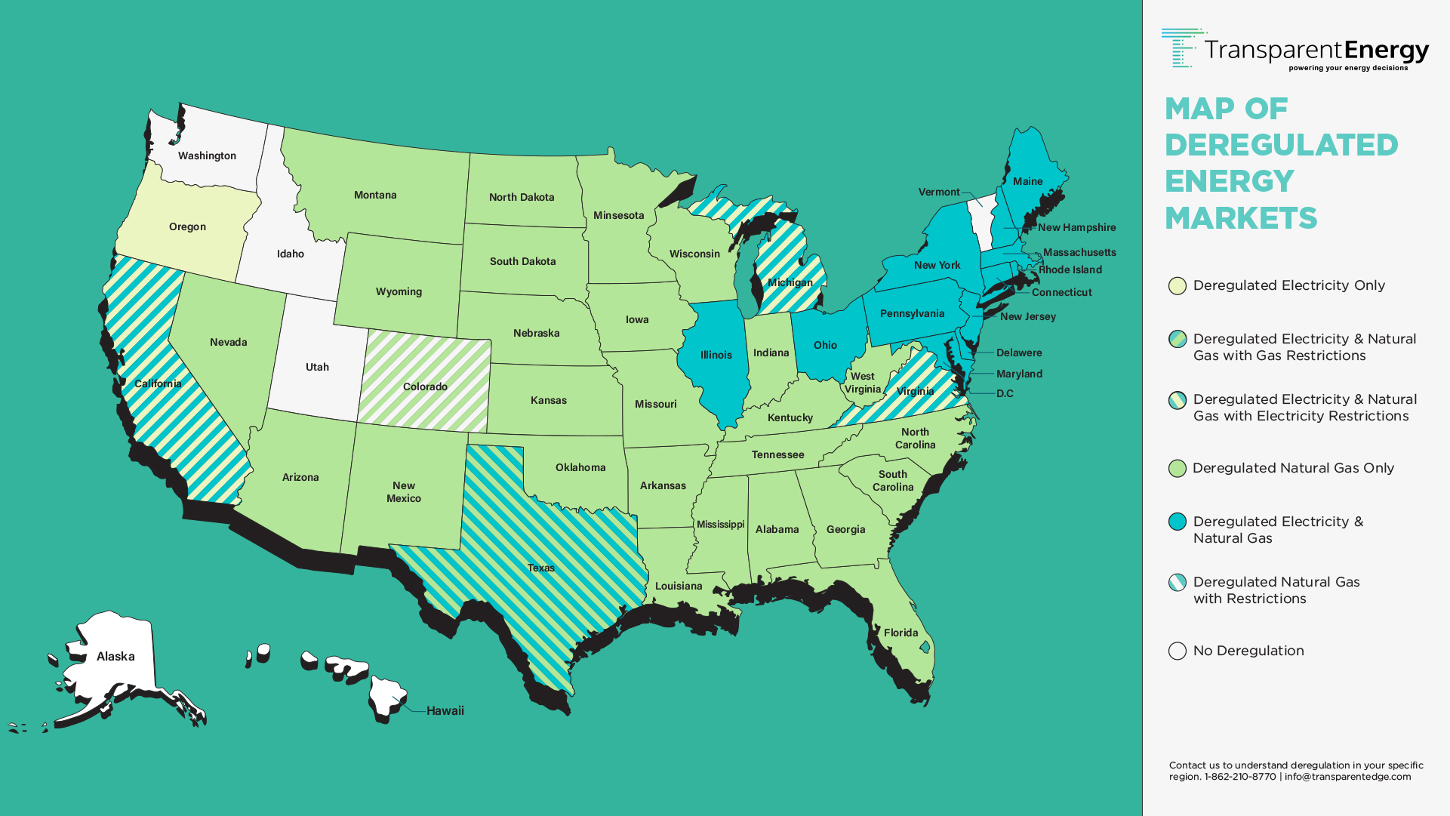
MAP OF DEREGULATED MARKETS

Slide 5
FUNDAMENTAL MARKET DRIVERS
Bull Drivers (Dynamics Driving Prices Higher)
U.S. LNG Exports continue to establish new records above 14 Bcf/day.
Domestic Natural Gas Production has fallen to a two-month low.
Bear Drivers (Dynamics Driving Prices Lower)
Natural Gas Inventories stand 42% over prior year at the likely end of withdrawal season.
Temperatures across the U.S. are expected to be relatively mild for the majority of April.
Asian Economies are not expected to show substantial recovery until Q3 of 2023.

Slide 6
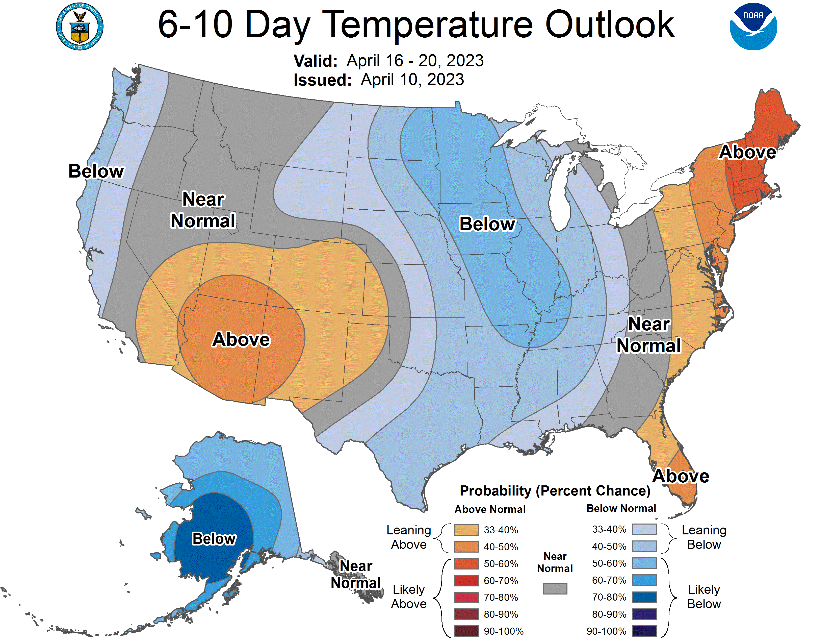
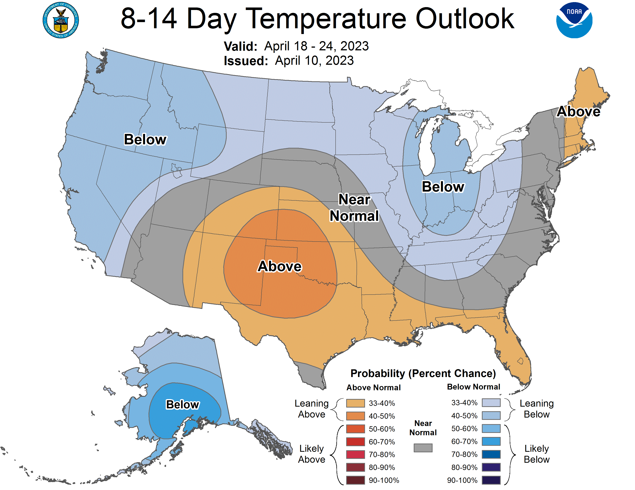
NOAA FORECASTS
Key Takeaway: NOAA temperatures outlooks expect normal to slightly cool temperatures for the majority of the US and warmer than average temperatures for the Eastern Seaboard. Price Impact: Neutral

Slide 7
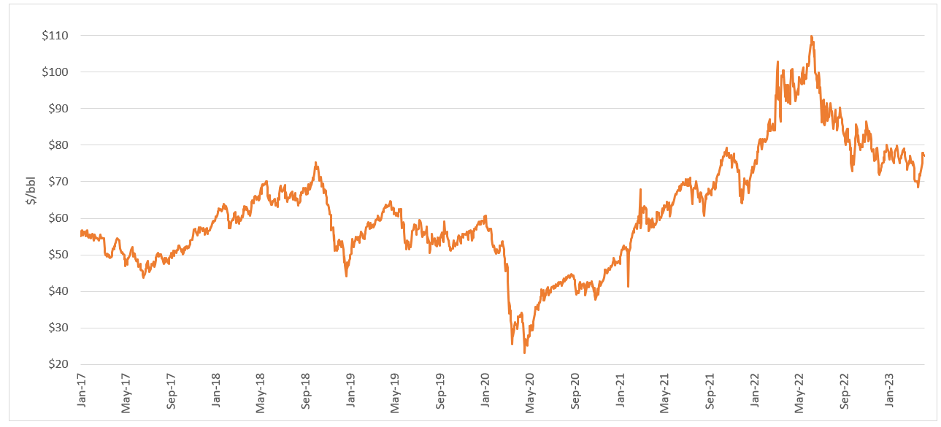
WTI - CRUDE OIL – 12 MONTH STRIP
7

Slide 8
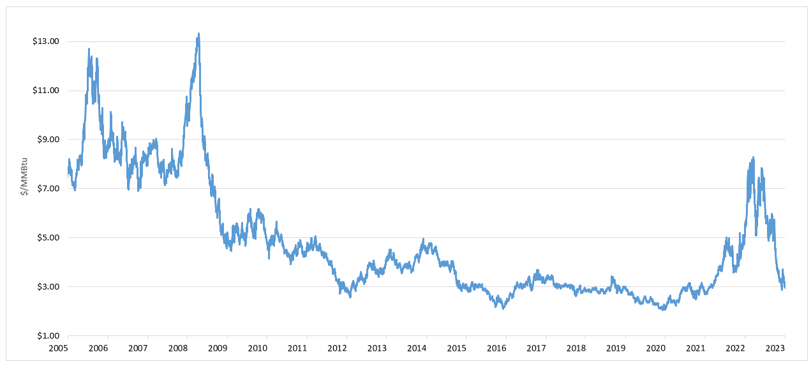
HENRY HUB – NATURAL GAS – 12 MONTH STRIP
8

Slide 9
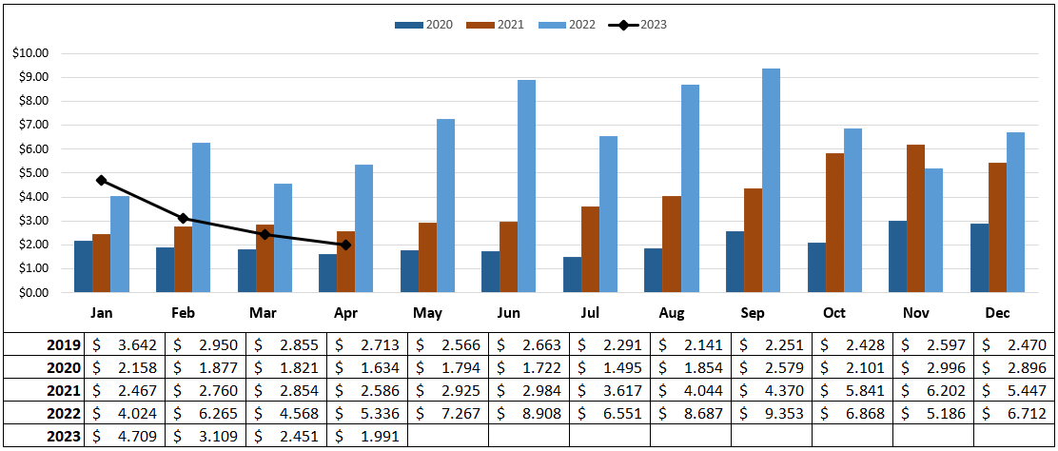
NYMEX MONTHLY NATURAL GAS SETTLEMENTS
(C) Premiere Marketing, LLC | All rights reserved.
9

Slide 10
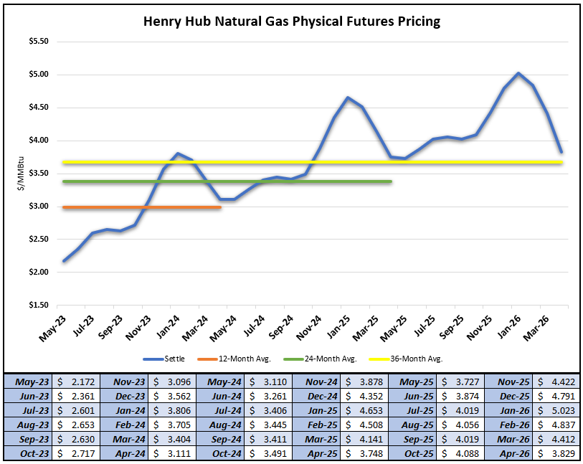
NATURAL GAS FUTURES PRICING

